Slide 1
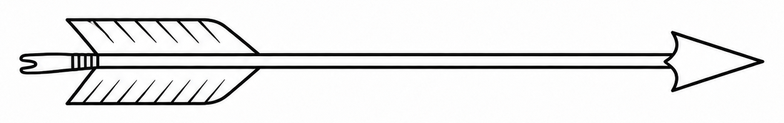
The Two Arrows Framework
First arrow: unavoidable unpleasantness.
Pain, fatigue, breathlessness, uncertainty, illness-related discomfort.
Second arrow: reactions that add distress.
Resistance, fear, judgment, tension, rumination, avoidance.
Key idea:
The first arrow is often not fully controllable.
The second arrow is more malleable.

Slide 2
The Two Arrows in Action
Example: a poor night’s sleep before an important day
First arrow: unavoidable unpleasantness.
Fatigue, heaviness, low energy, slower thinking.
Second arrow: reactions that add distress.
“Today is ruined”; “I won’t be able to function”;
Irritation, tension, anxious monitoring, and avoidance.

Slide 3
Psychological Processes Behind the Second Arrow
The second arrow can take several familiar psychological forms:
Experiential avoidance: Efforts to escape, suppress, or control unwanted internal experiences. (Hayes et al., 1996; Kashdan et al., 2006)
Distress intolerance: Difficulty staying present with aversive states without immediately escaping or avoiding them (Leyro et al., 2010; Simons & Gaher, 2005)
Anxiety sensitivity: Fear of bodily arousal sensations because they are interpreted as harmful or intolerable. (Olatunji & Wolitzky-Taylor, 2009)
Health relevance
These reactions can amplify distress and are linked to increased physical symptoms and maladaptive health behaviors. (Berghoff et al., 2017; DeWolfe et al., 2023; Mattingley et al., 2022; Otto & Smits, 2018)

Slide 4
Mindfulness Training and the Second Arrow
Monitor and Acceptance Theory (Lindsay & Creswell, 2017, 2019) highlights two complementary mindfulness processes:
Attention monitoring
Notice sensations, thoughts, and emotions.
Acceptance
Relate to experience with openness and non-judgment.
+
Why both matter: Monitoring helps us see the arrows; acceptance helps soften the second arrow.
Empirical support
Mindfulness training that includes acceptance reduces stress reactivity and improves emotional well-being. (Lindsay et al., 2019; Lindsay, Chin, et al., 2018; Lindsay, Young, et al., 2018)

